Slide 1

Adding To Your Arsenal
A Beginner’s Look at R
John Pertell
Database Administrator for Dialysis Clinics Inc
Email: jpertell@gmail.com
Twitter: @jayape
Blog: http://www.pertell.com/sqlservings
Link to slides and demo code: https://github.com/jayape/FoxPass

Slide 2
Who I am...
Working for DCI since 2000
Started as Access report writer
Have been Senior DBA since 2006

Slide 3
Who I am...NOT!
I am not an “R” tist

Slide 4
Agenda
A little R background
R History
What is R
Working in R
Basic syntax and objects
Functions
Adding and working with packages
Working with data – getting, shaping
Creating visualizations
R applications (R Markdown, Shiny)

Slide 5
Agenda (Time permitting)
R and Microsoft SQL 2016
What is it
Installing and configuring
Using R and SQL 2016

Slide 6
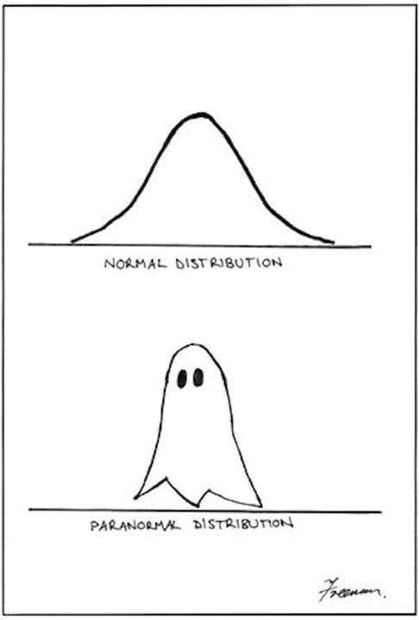
(Not on the)Agenda
Math and statistics
Well, maybe a little

Slide 7
A Little R Background
Open source language and environment for statistical computing and graphics
Dialect of S (statistical language created by Bell Labs)
Created in 1991 by Ross Ihaka and Robert Gentleman of University of Aukland
Version 1.0.0 released to public in 2000
Current version is 3.4.0 (You Stupid Darkness)

Slide 8
A Little R Background
One of the fastest growing, most popular languages for data scientists
Connects to many data sources
Runs on multiple platforms
Available from the CRAN repository
Constantly growing

Slide 9
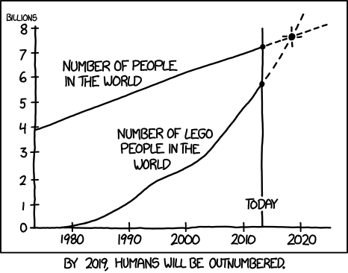
http://xkcd.com/1281/

Slide 10
A Little “R”efresher
Basic atomic classes of objects
Character
Numeric
Integer
Logical (True or False)
Most basic object is a vector
One dimensional
Can have more than one value
Can only contain objects of the same class (character, etc)
(But you can create a list with different classes)

Slide 11
A Little “R”efresher
Other object types:
Matrix – vectors with dimensions
Each element must be the same object class
Factors – represent categorical data
Useful for modeling data
Use labels (“Yes”, “No”) instead of integer(1, 2)
Data Frames – stores tabular data
Observations and variables instead of rows and columns
Can store different object classes in separate variables

Slide 12
A Little “R”efresher – Points to Remember
R is case sensitive
Variable A is not the same as variable a
You can use single (‘) or double (“) quotes around characters
But be consistent
You can use <- or = for assigning values
Again, be consistent
<- is preferred

Slide 13
A Little “R”efresher - Packages
install.packages(“package name”, lib = “path”)
lib = optional, path where package is installed
May be asked for mirror path
library(package name, lib.loc = “path”) – load package for use
Lib.loc is optional
Some popular packages
ggplot2 – plots
dplyr – manipulating data
RODBC – connections to ODBC data sources

Slide 14
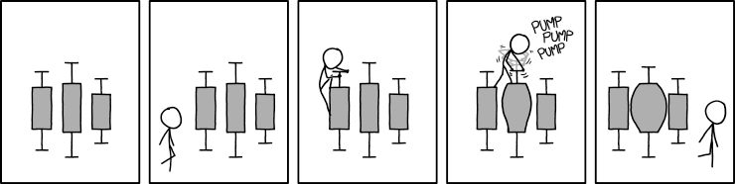

Slide 15
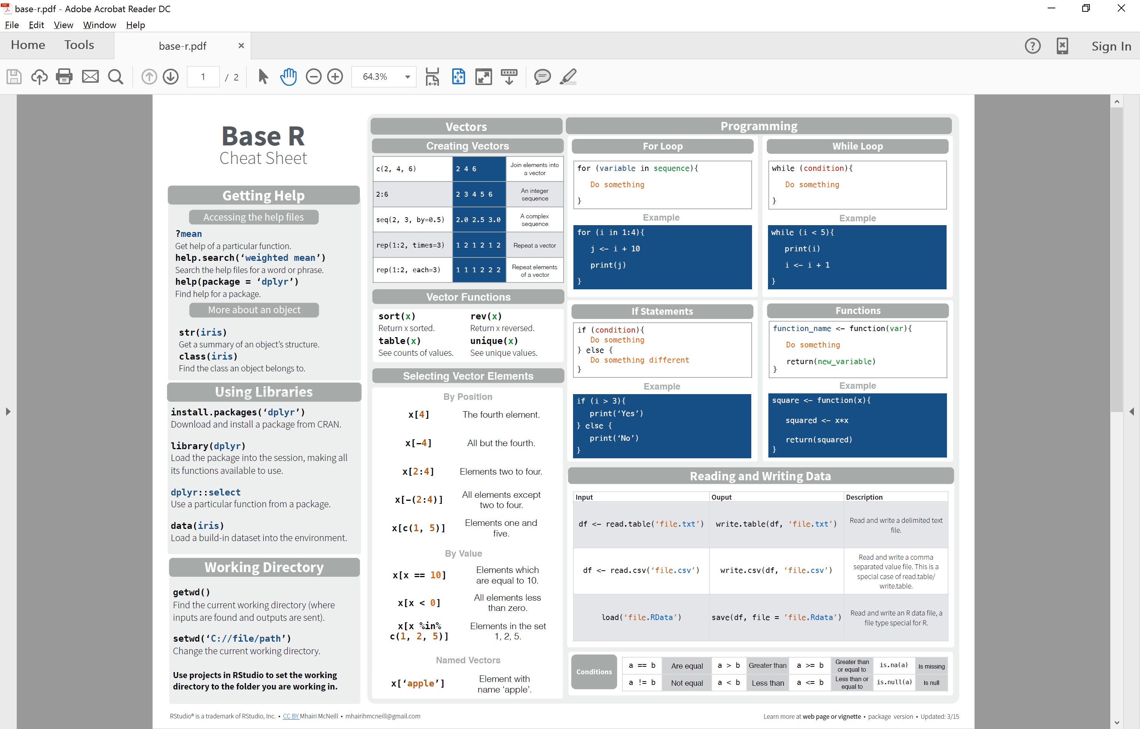

Slide 16
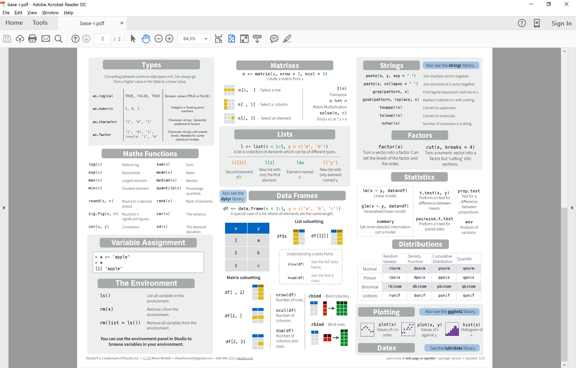

Slide 17
R Demo

Slide 18
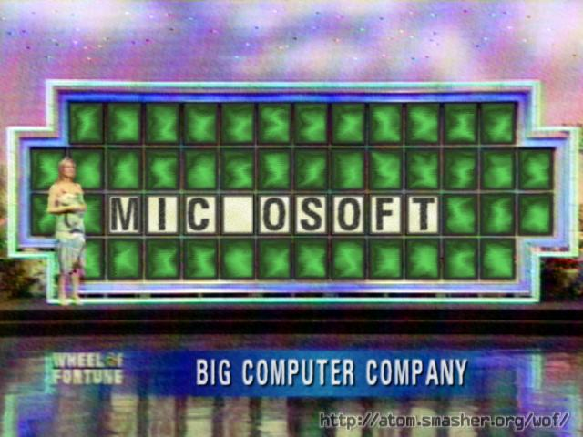
Microsoft and R

Slide 19
Microsoft and R
Microsoft acquires Revolution Analytics in early 2015
Announce integration of R and SQL 2016
Platinum member of R Consortium
MRAN (Microsoft R Application Network)

Slide 20
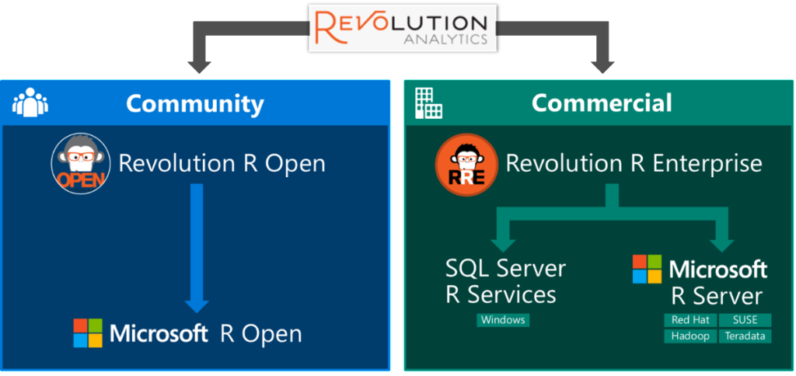
http://blog.revolutionanalytics.com/2016/01/microsoft-r-open.html

Slide 21
Microsoft R Open
Free and open source R distribution
Enhanced version of base R released by Revolution Analytics
Performance
Multithreading (available through MKL)
Package Time Machine (checkpointing) for reproducible code
Same functionality and access to R packages
Use any IDE to run scripts

Slide 22
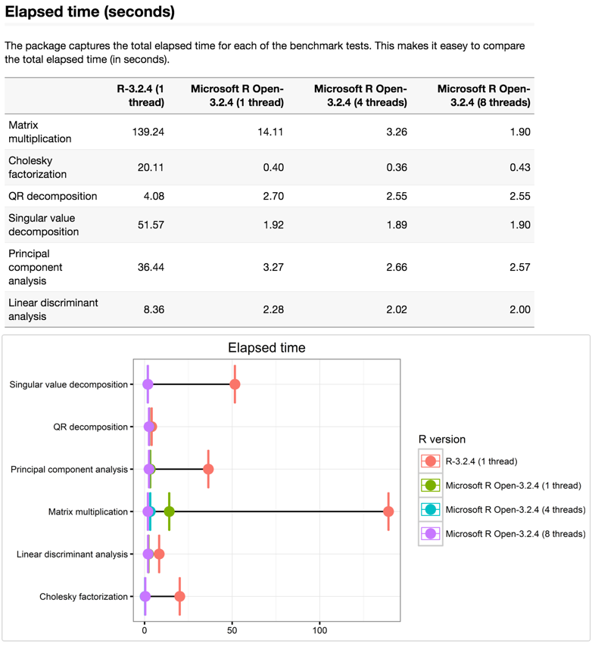
Microsoft R Open – Performance Comparison
SOURCE: https://mran.revolutionanalytics.com/documents/rro/multithread/

Slide 23
Microsoft R Server
Multi-platform (Windows, Linux, Hadoop, Teradata)
Parallel and chunked data processing
Work with larger data sets than base R

Slide 24
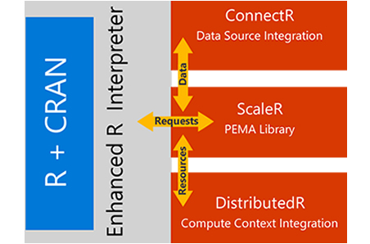
Microsoft R Server

Slide 25
SQL 2016 R Service
R Service (In-Database)
Advanced Analytics Extension
R scripts executed through system stored procedure
Close to the data
Use plots in SSRS

Slide 26
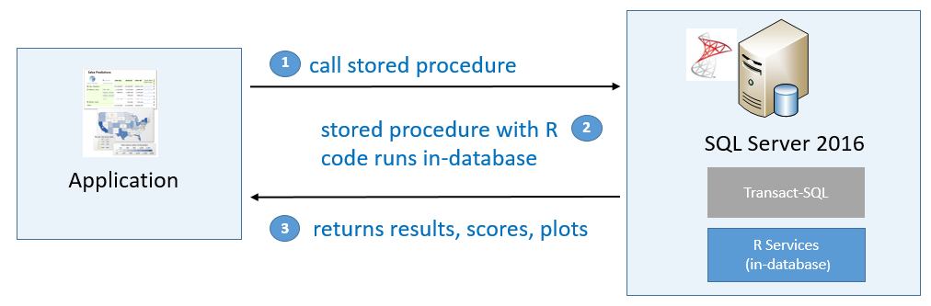
SQL 2016 R Service
SOURCE: https://msdn.microsoft.com/en-us/library/mt604885.aspx

Slide 27
SQL 2016 R Service
Install R Service Standalone if you just want the client
Choose R Services (In-Database) on each instance when installing
Choose R Server if you also want to install the client
If SQL instance is not connected to the internet:
Pause install when you get to screen agreeing to download R Open
Copy download link from popup screen
Download R service components on another computer and move to instance
Resume installation
Run EXEC sp_configure ‘external scripts enabled’, 1 after installation

Slide 28
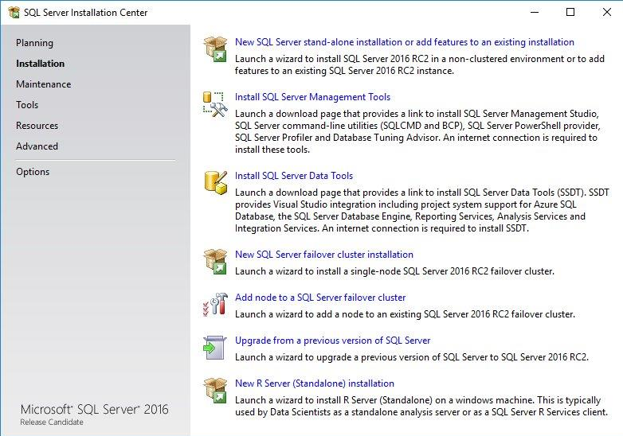

Slide 29
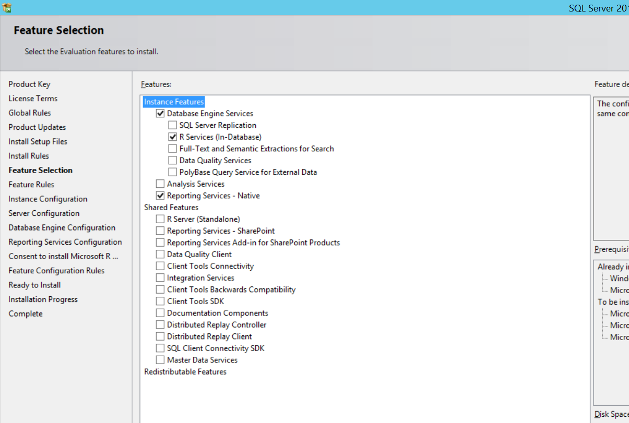

Slide 30
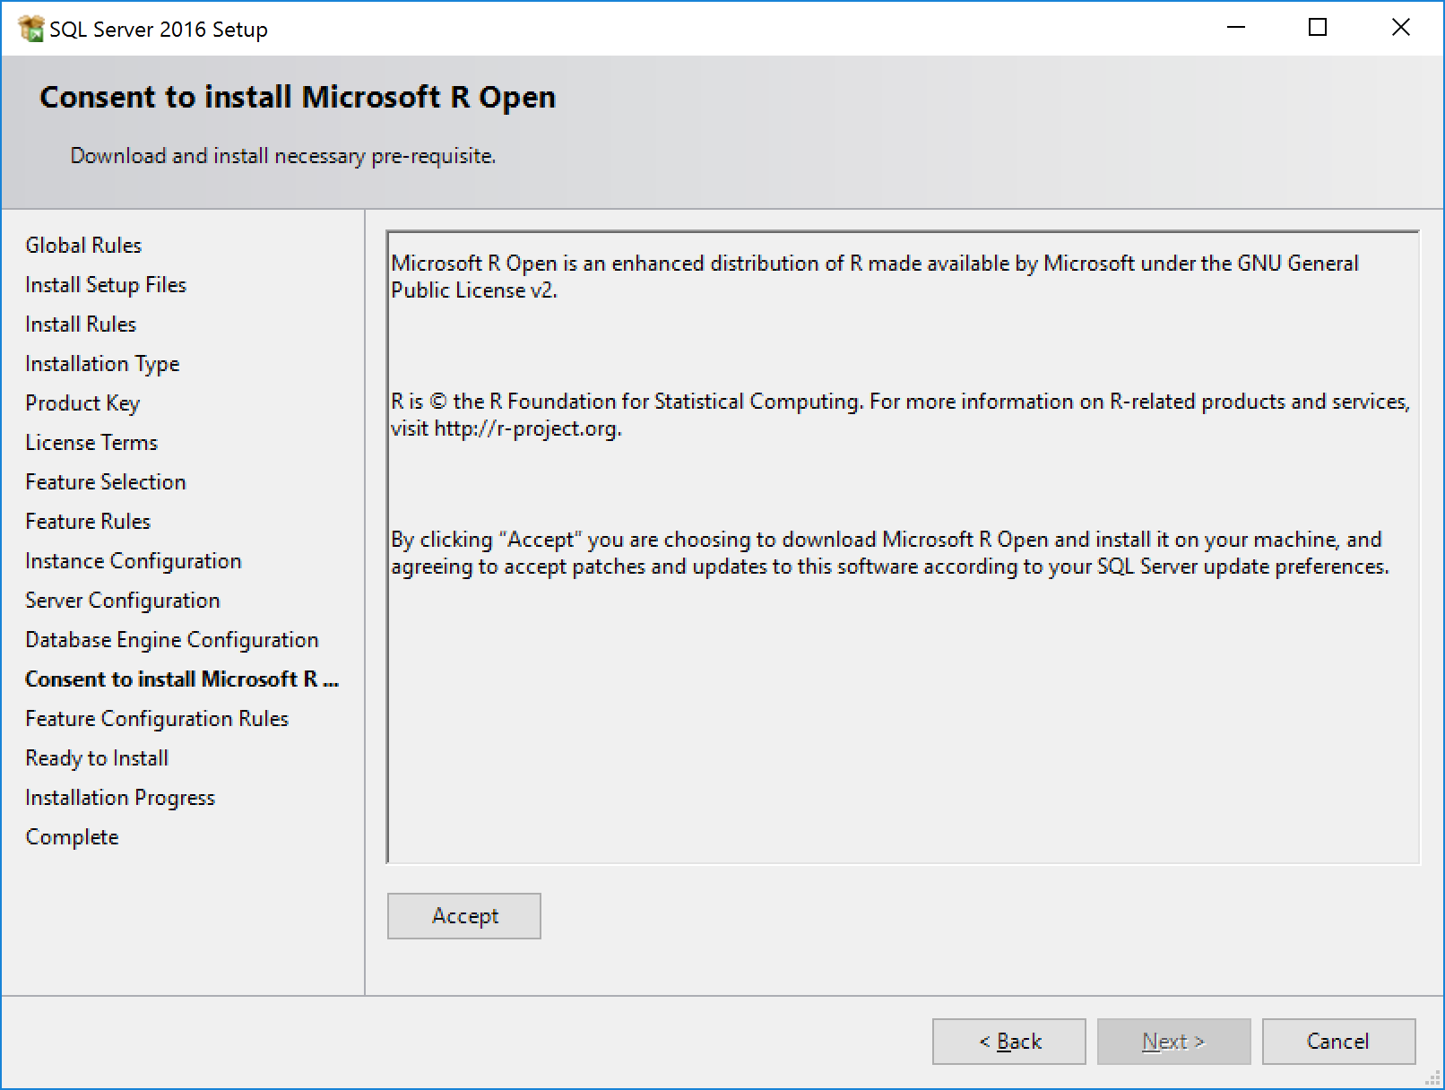

Slide 31
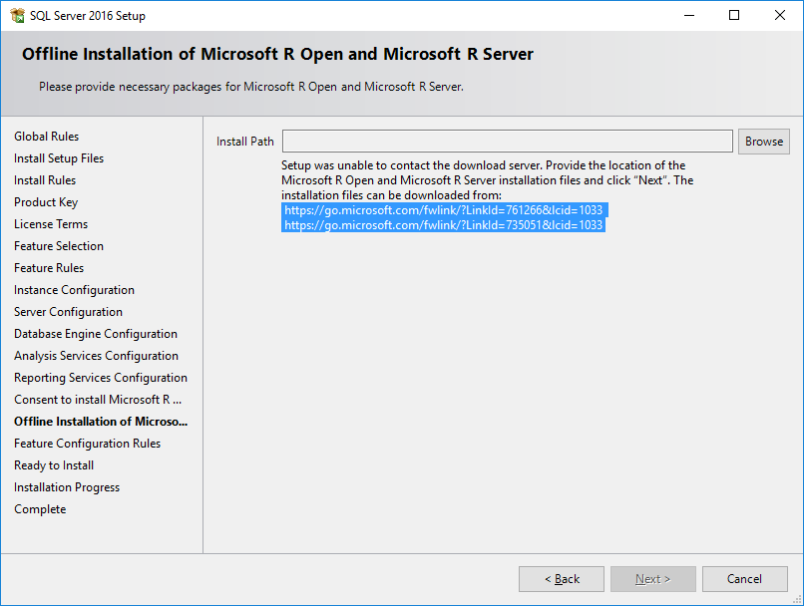

Slide 32
Configure Launchpad Service
<SQL installation path>\binn\Rlauncher.config
MEMORY_LIMIT_PERCENT (default is 20%)
TRACE_LEVEL (default is 1)
USER_POOL_SIZE (default is 0)
Other settings -- MSDN says don’t change
WORKING_DIRECTORY – for R sessions
JOB_CLEANUP_ON_EXIT – default is 1
LOG_DIRECTORY --
RHOME, MPI_HOME – directories for RRO and MPI

Slide 33
Configure RegisterRext.exe.config
C:\Program Files\Microsoft SQL Server\MSSQL13.MSSQLSERVER\R_SERVICES\library\RevoScaleR\rxLibs\x64\RegisterRext.exe.config
<add key="UserAccountPoolSize" value="20" />
Rerun registerRext.exe /uninstall (if you’re already run it once)
Rerun registerRext.exe /install

Slide 34
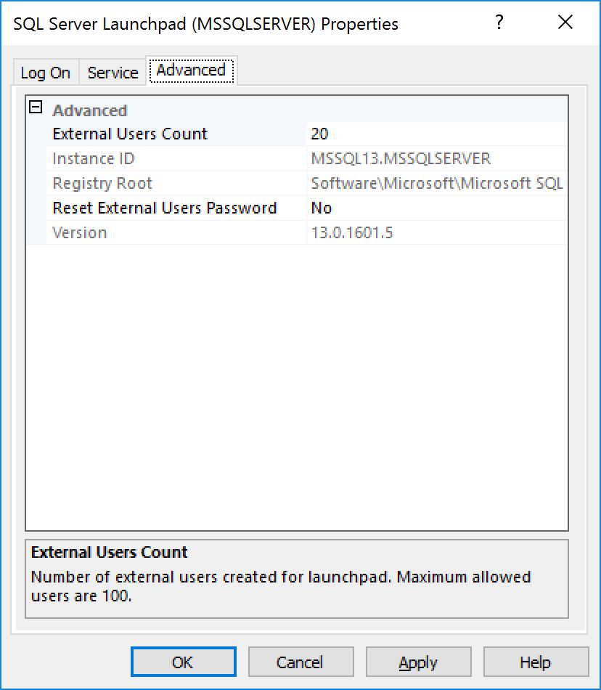
Configure RegisterRext.exe.config
The Easy Button

Slide 35
Packages
Default location C:/Program Files/Microsoft SQL Server/MSSQL13.MSSQLSERVER/R_SERVICES/library
Must install new packages as administrator
Permissions
In database:
GRANT EXECUTE ANY EXTERNAL SCRIPT TO <user name>

Slide 36
EXEC sp_execute_external_script
@language = N’language’,
@script = N’Your R code goes here’,
@input_data_1 = N’’,
[@input_data_1_name = N’’],
[@output_data_1_name = N’’],
[@parallel = 0 | 1],
[@params = N'@parameter_name data_type [ OUT | OUTPUT ] [ ,...n ]' ], [@parameter1 = 'value1' [ OUT | OUTPUT ] [ ,...n ] ]
WITH RESULT_SETS (
{column_name, data_type [,,,n]}
{UNDEFINED}
{NONE})

Slide 37
EXEC sp_execute_external_script…
RESULT SET must be a data frame from R
Only 1 RESULT SET allowed (may be more soon)
Only 1 input_data
Possible workaround – package inside your R code
SQL columns can’t be certain data types (nchar, nvarchar, cursor).
Convert before sending to R
Certain columns can’t recognized by R (AlwaysEncrypted, Masked)
Possible work around – put in temp table first.

Slide 38
SQL 2016 R Demos

Slide 39
Summary - 1
Microsoft acquired Revolution Analytics in 2015
Revolution R Open - Microsoft R Open(MRO)
Free, open source, enhanced version of R
Easier multithreading
Package Time Machine with checkpoint
Revolution R Enterprise - SQL 2016 R Server & Microsoft R Server
Advanced Analytics Extensions
Run R code in database through system stored procedure
Return results and plots to application

Slide 40
Summary - 2
Choose R (In Database)feature during SQL install
Install RRO and RRE (before RC2 or if server has no internet)
Sp_configure ‘external_scripts_enabled’, 1
Configure Rlaunchpad for memory
Configure RegisterRext.exe.config for user account sessions
Run R code through sp_execute_external_script
Only 1 input and 1output
R must return data frame

Slide 41
Base R References
Comprehensive R Archive Network (CRAN) https://www.cran.r-project.org/
R Tutorial https://cran.r-project.org/doc/manuals/R-intro.html
R Cheatsheets https://www.rstudio.com/resources/cheatsheets/
R-bloggers https://www.r-bloggers.com/
R Exercises http://www.r-exercises.com/

Slide 42
Microsoft R Open References
MSDN: SQL Server R Services https://msdn.microsoft.com/en-us/library/mt604845.aspx
MSDN: Getting Started with SQL Server R Services https://msdn.microsoft.com/en-us/library/mt604885.aspx
MSDN: sp_execute_external_script (Transact-SQL) https://msdn.microsoft.com/en-us/library/mt604368.aspx
MSDN: Configure and Manage Advanced Analytics Extensions
https://msdn.microsoft.com/en-US/library/mt590869.aspx
Microsoft R Application Network (MRAN) https://mran.revolutionanalytics.com/

Slide 43
References – 2

Slide 44
THANK YOU!
Email: jpertell@gmail.com
Twitter: @jayape
Blog: http://www.pertell.com/sqlservings
Link to slides and demo code: https://github.com/jayape/FoxPass

